Slide 1
Logistic Regression
Prof. Andy Field

Slide 2
Aims
When and why do we use logistic regression?
  Binary
  Multinomial
Theory behind logistic regression
  Assessing the model
  Assessing predictors
  Things that can go wrong
Interpreting logistic regression

Slide 3
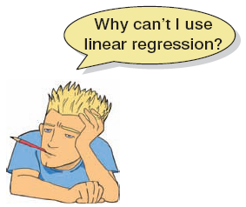
When and Why
To predict an outcome variable that is categorical from one or more categorical or continuous predictor variables.
Used because having a categorical outcome variable violates the assumption of linearity in normal regression.

Slide 4
With One Predictor
Outcome
  We predict the probability of the outcome occurring
b₀ and b₁
  Can be thought of in much the same way as multiple regression
  Note the normal regression equation forms part of the logistic regression equation

Slide 5
With Several Predictors
Outcome
  We still predict the probability of the outcome occurring
Differences
  Note the multiple regression equation forms part of the logistic regression equation
  This part of the equation expands to accommodate additional predictors

Slide 6
Assessing the Model
N
∑
[
(
(
)
]
)
(
)
(
(
)
log
−
likelihood
=
Y
ln
P
Y
+
1
−
Y
ln
1
−
P
Y
)
i
i
i
i
i
=
1
The log-likelihood statistic
  Analogous to the residual sum of squares in multiple regression
  It is an indicator of how much unexplained information there is after the model has been fitted.
  Large values indicate poorly fitting statistical models.

Slide 7
Assessing Changes in Models
It’s possible to calculate a log-likelihood for different models and to compare these models by looking at the difference between their log-likelihoods.
2
[
]
χ
=
2
(
)
−
(
)
LL
new
LL
baseline
(
=
−
)
df
k
k
new
baseline

Slide 8
Assessing Predictors: The Wald Statistic
Similar to t-statistic in regression.
Tests the null hypothesis that b = 0.
Is biased when b is large.
Better to look at likelihood ratio statistics.

Slide 9
Assessing Predictors:
The Odds Ratio
Indicates the change in odds resulting from a unit change in the predictor.
  OR > 1: Predictor ↑, Probability of outcome occurring ↑.
  OR < 1: Predictor ↑, Probability of outcome occurring ↓.

Slide 10

Methods of Regression
Forced entry: all variables entered simultaneously.
Hierarchical: variables entered in blocks.
  Blocks should be based on past research, or theory being tested. Good method.
Stepwise: variables entered on the basis of statistical criteria (i.e. relative contribution to predicting outcome).
  Should be used only for exploratory analysis.

Slide 11
Things That Can Go Wrong
Assumptions from linear regression:
  Linearity
  Independence of errors
  Multicollinearity
Unique problems
  Incomplete information
  Complete separation
  Overdispersion

Slide 12
Incomplete Information from the Predictors
Categorical predictors:
  Predicting cancer from smoking and eating tomatoes.
  We don’t know what happens when non-smokers eat tomatoes because we have no data in this cell of the design.
Continuous variables
  Will your sample include an 80-year-old, highly anxious, Buddhist, left-handed lesbian?

Slide 13
Complete Separation
When the outcome variable can be perfectly predicted.
  E.g. predicting whether someone is a burglar, your teenage son or your cat based on weight.
  Weight is a perfect predictor of cat/burglar unless you have a very fat cat indeed!

Slide 14
Overdispersion
Overdispersion is where the variance is larger than expected from the model.
This can be caused by violating the assumption of independence.
This problem makes the standard errors too small!

Slide 15
An Example
Predictors of a treatment intervention.
Participants
  113 adults with a medical problem
Outcome:
  Cured (1) or not cured (0).
Predictors:
  Intervention: intervention or no treatment.
  Duration: the number of days before treatment that the patient had the problem.

Slide 16
Basic Logistic Regression Analysis Using R Commander
Reordering a factor in R Commander

Slide 17
Basic Logistic Regression Analysis Using R Commander
Dialog box for generalized linear models in R Commander

Slide 18
Basic Logistic Regression Analysis Using R
  newModel<-glm(outcome ~ predictor(s), data = dataFrame, family = name of a distribution, na.action = an action)

Slide 19
Hierarchical Regression Using R
Model 1:
  eelModel.1 <- glm(Cured ~ Intervention, data = eelData, family = binomial())
Model 2:
  eelModel.2 <- glm(Cured ~ Intervention + Duration, data = eelData, family = binomial())
  summary(eelModel.1)
  summary(eelModel.2)

Slide 20
Output Model 1: Intervention Only
  Call:
  glm(formula = Cured ~ Intervention, family = binomial(), data = eelData)
  Deviance Residuals:
  Min 1Q Median 3Q Max
  -1.5940 -1.0579 0.8118 0.8118 1.3018
  Coefficients:
  Estimate Std. Error z value Pr(>|z|)
  (Intercept) -0.2877 0.2700 -1.065 0.28671
  InterventionIntervention 1.2287 0.3998 3.074 0.00212 **
  (Dispersion parameter for binomial family taken to be 1)
  Null deviance: 154.08 on 112 degrees of freedom
  Residual deviance: 144.16 on 111 degrees of freedom
  AIC: 148.16

Slide 21
Improvement: Model 1
Find the improvement:
  modelChi <- eelModel.1$null.deviance - eelModel.1$deviance
  modelChi
  [1] 9.926201
degrees of freedom :
  chidf <- eelModel.1$df.null - eelModel.1$df.residual
  chidf
  [1] 1
To calculate the probability associated with this chi-square statistic we can use the pchisq() function.
  chisq.prob <- 1 - pchisq(modelChi, chidf)
  chisq.prob
  [1] 0.001629425

Slide 22
Writing a Function to Compute R²
  logisticPseudoR2s <- function(LogModel) {
  dev <- LogModel$deviance
  nullDev <- LogModel$null.deviance
  modelN <- length(LogModel$fitted.values)
  R.l <- 1 - dev / nullDev
  R.cs <- 1- exp ( -(nullDev - dev) / modelN)
  R.n <- R.cs / ( 1 - ( exp (-(nullDev / modelN))))
  cat("Pseudo R^2 for logistic regression\n")
  cat("Hosmer and Lemeshow R^2 ", round(R.l, 3), "\n")
  cat("Cox and Snell R^2 ", round(R.cs, 3), "\n")
  cat("Nagelkerke R^2 ", round(R.n, 3), "\n")
  }

Slide 23
Writing a Function to Compute R²
To use the function on our model, we simply place the name of the logistic regression model (in this case eelModel.1) in the function and execute:
  logisticPseudoR2s(eelModel.1)
The output will be:
  Pseudo R^2 for logistic regression
  Hosmer and Lemeshow R^2 0.064
  Cox and Snell R^2 0.084
  Nagelkerke R^2 0.113

Slide 24
Calculating the Odds Ratio
We can also calculate the odds ratio as the exponential of the b coefficient for the predictor variables by executing:
  exp(eelModel.1$coefficients)
  (Intercept) InterventionIntervention
  0.750000 3.416667
To get the confidence intervals execute:
  exp(confint(eelModel.1))
  2.5 % 97.5 %
  (Intercept) 0.4374531 1.268674
  InterventionIntervention 1.5820127 7.625545

Slide 25
Output Model 2: Intervention and Duration as Predictors
  Call:
  glm(formula = Cured ~ Intervention + Duration, family = binomial(),
  data = eelData)
  Deviance Residuals:
  Min 1Q Median 3Q Max
  -1.6025 -1.0572 0.8107 0.8161 1.3095
  Coefficients:
  Estimate Std. Error z value Pr(>|z|)
  (Intercept) -0.234660 1.220563 -0.192 0.84754
  InterventionIntervention 1.233532 0.414565 2.975 0.00293 **
  Duration -0.007835 0.175913 -0.045 0.96447
  (Dispersion parameter for binomial family taken to be 1)
  Null deviance: 154.08 on 112 degrees of freedom
  Residual deviance: 144.16 on 110 degrees of freedom
  AIC: 150.16

Slide 26
Improvement: Model 2
We can compare the models by finding the difference in the deviance statistics as before.
Or we can use the anova() function:
  anova(eelModel.1, eelModel.2)
  >Analysis of Deviance Table
  Model 1: Cured ~ Intervention
  Model 2: Cured ~ Intervention + Duration
  Resid. Df Resid. Dev Df Deviance
  1 111 144.16
  2 110 144.16 1 0.0019835

Slide 27

Summary
The overall fit of the final model is shown by the deviance statistic and its associated chi-square statistic.
  If the significance of the chi-square statistic is less than .05, then the model is a significant fit to the data.
Check the table labelled coefficients to see which variables significantly predict the outcome.
For each variable in the model, look at the z-statistic and its significance (which again should be below .05).
Use the odds ratio for interpretation. You can obtain this using exp(model$coefficients), where model is the name of your model.
  If the value is greater than 1 then as the predictor increases, the odds of the outcome occurring increase.
  A value less than 1 indicates that as the predictor increases, the odds of the outcome occurring decrease.
  For the aforementioned interpretation to be reliable the confidence interval of the odds ratio should not cross 1!

Slide 28
Reporting the Analysis

Slide 29
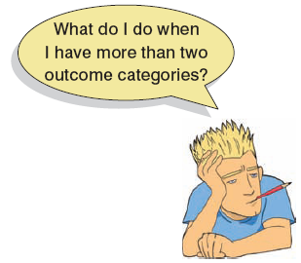
Multinomial Logistic Regression
Logistic regression to predict membership of more than two categories.
It (basically) works in the same way as binary logistic regression.
The analysis breaks the outcome variable down into a series of comparisons between two categories.
  E.g., if you have three outcome categories (A, B and C), then the analysis will consist of two comparisons that you choose:
    compare everything against your first category (e.g. A vs. B and A vs. C),
    or your last category (e.g. A vs. C and B vs. C),
    or a custom category (e.g. B vs. A and B vs. C).
The important parts of the analysis and output are much the same as we have just seen for binary logistic regression.

Slide 30
I May Not Be Fred Flintstone …
How successful are chat-up lines?
The chat-up lines used by 348 men and 672 women in a nightclub were recorded.
Outcome:
  Whether the chat-up line resulted in one of the following three events:
    the person got no response or the recipient walked away;
    the person obtained the recipient’s phone number;
    the person left the nightclub with the recipient.
Predictors:
  The content of the chat-up lines were rated for:
    funniness (0 = not funny at all, 10 = the funniest thing that I have ever heard);
    sexuality (0 = no sexual content at all, 10 = very sexually direct);
    moral values (0 = the chat-up line does not reflect good characteristics, 10 = the chat-up line is very indicative of good characteristics).
  Gender of recipient

Slide 31
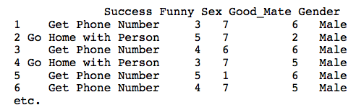
Multinomial Logistic Regression in R
We can use the mlogit.data() function to convert our data into the correct format:
  newDataframe<-mlogit.data(oldDataFrame, choice = "outcome variable", shape = "wide"/"long")

Slide 32
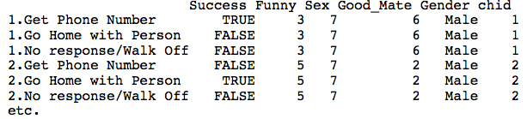
Restructuring the Data
Therefore, to restructure the current data we could execute:
  mlChat <- mlogit.data(chatData, choice = "Success", shape = "wide”)

Slide 33
Running Multinomial Regression
Now we are ready to run the multinomial logistic regression, using the mlogit() function:
  newModel<-mlogit(outcome ~ predictor(s), data = dataFrame, na.action = an action, reflevel = a number representing the baseline category for the outcome)
We can, therefore, create the model by executing:
  chatModel <- mlogit(Success ~ 1 | Good_Mate + Funny + Gender + Sex + Gender:Sex + Funny:Gender, data = mlChat, reflevel = 3)
  summary(chatModel)

Slide 34
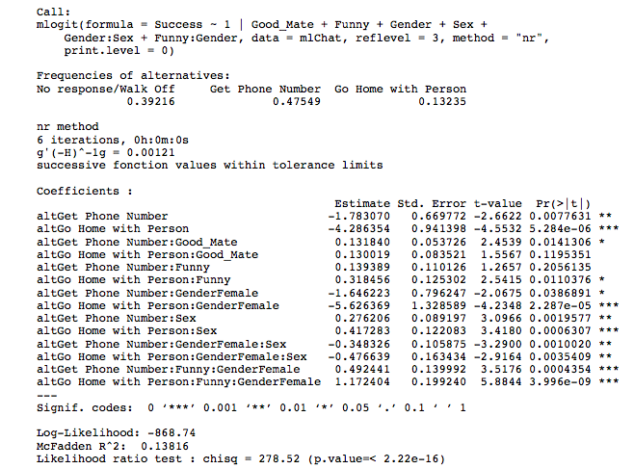

Slide 35
Interpretation
To help with the interpretation we can exponentiate the coefficients:
  exp(chatModel$coefficients)
We can make the output nicer by asking R to print the variable as a dataframe:
  data.frame(exp(chatModel$coefficients))

Slide 36
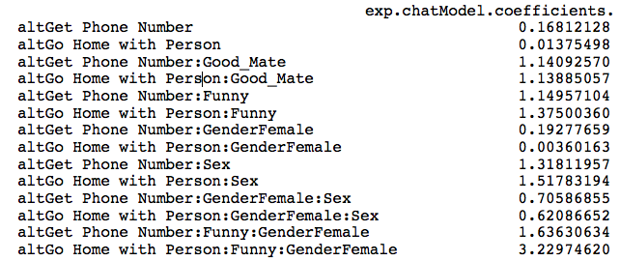
Exponentiated Coefficients

Slide 37
Confidence Intervals
We can get confidence intervals for these coefficients using the confint() function:
  exp(confint(chatModel))

Slide 38
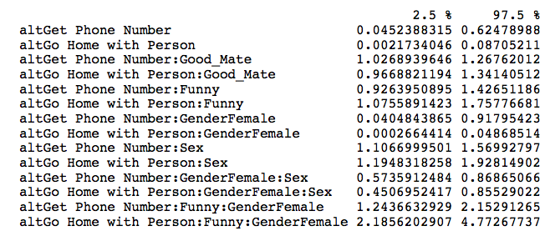
Confidence Intervals

Slide 39
Interpretation:
Phone Number vs. No Response
Good_Mate: Whether the chat-up line showed signs of good moral fibre significantly predicted whether you got a phone number or no response/walked away, b = 0.13, Wald χ²(1) = 6.02, p < .05.
Funny: Whether the chat-up line was funny did not significantly predict whether you got a phone number or no response, b = 0.14, Wald χ²(1) = 1.60, p > .05.
Gender: The gender of the person being chatted up significantly predicted whether they gave out their phone number or gave no response, b = −1.65, Wald χ²(1) = 4.27, p < .05.
Sex: The sexual content of the chat-up line significantly predicted whether you got a phone number or no response/walked away, b = 0.28, Wald χ²(1) = 9.59, p < .01.
Funny × Gender: The success of funny chat-up lines depended on whether they were delivered to a man or a woman because in interaction these variables predicted whether or not you got a phone number, b = 0.49, Wald χ²(1) = 12.37, p < .001.
Sex × Gender: The success of chat-up lines with sexual content depended on whether they were delivered to a man or a woman because in interaction these variables predicted whether or not you got a phone number, b = −0.35, Wald χ²(1) = 10.82, p < .01.

Slide 40
Interpretation:
Going Home vs. No Response
Good_Mate: Whether the chat-up line showed signs of good moral fibre did not significantly predict whether you went home with the date or got a slap in the face, b = 0.13, Wald χ²(1) = 2.42, p > .05.
Funny: Whether the chat-up line was funny significantly predicted whether you went home with the date or no response, b = 0.32, Wald χ²(1) = 6.46, p < .05.
Gender: The gender of the person being chatted up significantly predicted whether they went home with the person or gave no response, b = −5.63, Wald χ²(1) = 17.93, p < .001.
Sex: The sexual content of the chat-up line significantly predicted whether you went home with the date or got a slap in the face, b = 0.42, Wald χ²(1) = 11.68, p < .01.
Funny × Gender: The success of funny chat-up lines depended on whether they were delivered to a man or a woman because in interaction these variables predicted whether or not you went home with the date, b = 1.17, Wald χ²(1) = 34.63, p < .001.
Sex × Gender: The success of chat-up lines with sexual content depended on whether they were delivered to a man or a woman because in interaction these variables predicted whether or not you went home with the date, b = −0.48, Wald χ²(1) = 8.51, p < .01.

Slide 41
Reporting the Results

